Slide 1

Machine Learning & Data Mining CS/CNS/EE 155
Lecture 8:
Structural SVMs Part 2 &
General Structured Prediction

Slide 2
Announcements
Homework 2 due next Tuesday
2pm via Moodle
Homework 3 out next week
Due 2 weeks later
(Easier than HW2)
Kaggle Mini-Project out next week
Due ~3 weeks later

Slide 3
Kaggle Mini-Project
Training set of ~5K labeled data points
~50 features
Test set of unlabeled data points
Submit predictions on test set
You choose the methods, loss functions, feature manipulations, etc.
Expected to do cross validation & model selection
Written report
Clearly & concisely documenting your process
Template will be provided
Groups of up to 3
Due after ~3 weeks

Slide 4
Today
Structural SVMs
Recap of Previous Lecture
Training
General Structured Prediction
Brief Overview

Slide 5
Recap: 1st Order Sequential Model
POS Tags:
Det, Noun, Verb, Adj, Adv, Prep
Input: x = (x¹,…,x^{M})
Predict: y = (y¹,…,y^{M})
Each y^{i} one of L labels.
Linear Model w.r.t. pairwise features φ^{j}(a,b|x):
Prediction via maximizing F:
L=6

Slide 6
Recap: Simple Example
“Unary Features”
“Pairwise Transition Features”

Slide 7
x = “Fish Sleep” y = (N,V)
y | F(y,x)
(N,N) | 2+1+1-2 = 2
(N,V) | 2+1+0+1 = 4
(V,N) | 1-1+1+2 = 3
(V,V) | 1-1+0-2 = -1
Prediction:

Slide 8
Structured Prediction
Complex output spaces
All possible Part-of-Speech sequences
Naïve prediction is often exponential time:
Evaluation is also multivariate:
E.g., Hamming Loss

Slide 9
Examples of Complex Output Spaces
Natural Language Parsing
Given a sequence of words x, predict the parse tree y.
Dependencies from structural constraints, since y has to be a tree.
y
S
x
NP
VP
The dog chased the cat
NP
Det
N
V
Det
N

Slide 10
Examples of Complex Output Spaces
Information Retrieval
Given a query x, predict a ranking y.
Dependencies between results (e.g. avoid redundant hits)
Loss function over rankings (e.g. Average Precision)
x
y
Kernel-Machines
SVM-Light
Learning with Kernels
SV Meppen Fan Club
Service Master & Co.
School of Volunteer Management
SV Mattersburg Online
…
SVM

Slide 11
Examples of Complex Output Spaces
X
Y
X
Y
Co-reference Resolution
Protein Folding
X
Y
Stereo (binocular) Depth Detection
Will see examples later in lecture.

Slide 12
Training Structured Prediction Models
General Form:
Or equivalently:
Require continuous surrogate of evaluation measure.

Slide 13
Structural SVM
Sometimes
normalize by M
“Slack”
Consider:
➔
Prediction of Learned Model
➔
Slack is continuous
upper bound on
Hamming Loss!
➔

Slide 14
Example 1
x_{i} = “Fish Sleep”
y’ | F(y’,x_{i}) | F(y_{i},x_{i}) – F(y’,x_{i}) | Loss
(N,N) | 2 | 2 | 1
(N,V) | 4 | 0 | 0
(V,N) | 1 | 3 | 2
(V,V) | 1 | 3 | 1
y_{i} = (N,V)

Slide 15
Example 2
x_{i} = “Fish Sleep”
y’ | F(y’,x_{i}) | F(y_{i},x_{i}) – F(y’,x_{i}) | Loss
(N,N) | 4 | -1 | 1
(N,V) | 3 | 0 | 0
(V,N) | 0 | 3 | 2
(V,V) | 1 | 2 | 1
y_{i} = (N,V)

Slide 16
Example 3
x_{i} = “Fish Sleep”
y’ | F(y’,x_{i}) | F(y_{i},x_{i}) – F(y’,x_{i}) | Loss
(N,N) | 2 | 2 | 1
(N,V) | 4 | 0 | 0
(V,N) | 3 | 1 | 2
(V,V) | 1 | 3 | 1
y_{i} = (N,V)

Slide 17
When is Slack Positive?
Hamming Hinge Loss
Whenever margin not big enough!
⬅
➔
Verify that above definition ≥0

Slide 18
Structural SVM
Geometric Interpretation
≤0➔
High Dimensional Point
w
y_{i}
y’
Size of Margin
vs
Size of Margin Violations
(C controls trade-off)
(Margin scaled by Hamming Loss)
y’

Slide 19
Structural SVM Training
Often Exponentially Many!
Strictly convex optimization problem
Same form as standard SVM optimization
Easy right?
Intractable # of constraints!

Slide 20
Structural SVM Training
The trick is to not enumerate all constraints.
Only solve the SVM objective over a small subset of constraints (working set).
Efficient!
But some constraints might be violated.

Slide 21


Example
y’ | F(y’,x_{i}) | F(y_{i},x_{i}) – F(y’,x_{i}) | Loss
(N,N) | 2 | 2 | 1
(N,V) | 4 | 0 | 0
x_{i} = “Fish Sleep”
y’ | F(y’,x_{i}) | F(y_{i},x_{i}) – F(y’,x_{i}) | Loss
(N,N) | 2 | 2 | 1
(N,V) | 4 | 0 | 0
(V,N) | 3 | 1 | 2
(V,V) | 1 | 3 | 1
y_{i} = (N,V)

Slide 22
Approximate Hinge Loss
Choose tolerate ε>0:
Consider:
➔
Prediction of Learned Model
Slack is continuous
upper bound on
Hamming Loss - ε!
➔
➔

Slide 23
Example
y’ | F(y’,x_{i}) | F(y_{i},x_{i}) – F(y’,x_{i}) | Loss
(N,N) | 2 | 2 | 1
(N,V) | 4 | 0 | 0
x_{i} = “Fish Sleep”
y’ | F(y’,x_{i}) | F(y_{i},x_{i}) – F(y’,x_{i}) | Loss
(N,N) | 2 | 2 | 1
(N,V) | 4 | 0 | 0
(V,N) | 3 | 1 | 2
(V,V) | 1 | 3 | 1
y_{i} = (N,V)

Slide 24
Structural SVM Training
STEP 0: Specify tolerance ε
STEP 1: Solve SVM objective function using only working set of constraints W (initially empty). The trained model is w.
STEP 2: Using w, find the y’ whose constraint is most violated.
STEP 3: If constraint is violated by more than ε, add it to W.
Repeat STEP 1-3 until no additional constraints are added. Return most recent model w trained in STEP 1.
Constraint Violation
Formula:
*This is known as a “cutting plane” method.

Slide 25
Example
Choose ε=0.1
Init:
Solve:
x_{i} = “Fish Sleep”
y’ | F(y’,x_{i}) | F(y_{i},x_{i}) – F(y’,x_{i}) | Loss | Viol.
(N,N) | 0 | 0 | 1 | 1
(N,V) | 0 | 0 | 0 | 0
(V,N) | 0 | 0 | 2 | 2
(V,V) | 0 | 0 | 1 | 1
y_{i} = (N,V)
Constraint Violation:
Loss – Slack – ( F(y,x)-F(y’,x) ) = Viol

Slide 26
Example
Choose ε=0.1
Update:
Solve:
x_{i} = “Fish Sleep”
y’ | F(y’,x_{i}) | F(y_{i},x_{i}) – F(y’,x_{i}) | Loss | Viol.
(N,N) | 0 | 0 | 1 | 1
(N,V) | 0 | 0 | 0 | 0
(V,N) | 0 | 0 | 2 | 2
(V,V) | 0 | 0 | 1 | 1
y_{i} = (N,V)
Constraint Violation:
Loss – Slack – ( F(y,x)-F(y’,x) ) = Viol

Slide 27
Example
Choose ε=0.1
Update:
Solve:
x_{i} = “Fish Sleep”
y’ | F(y’,x_{i}) | F(y_{i},x_{i}) – F(y’,x_{i}) | Loss | Viol.
(N,N) | 0.7 | 0.2 | 1 | 0.2
(N,V) | 0.9 | 0 | 0 | 0
(V,N) | -0.6 | 1.5 | 2 | 0
(V,V) | 0 | 0.9 | 1 | 0.4
y_{i} = (N,V)
Constraint Violation:
Loss – Slack – ( F(y,x)-F(y’,x) ) = Viol

Slide 28
Example
Choose ε=0.1
Update:
Solve:
x_{i} = “Fish Sleep”
y’ | F(y’,x_{i}) | F(y_{i},x_{i}) – F(y’,x_{i}) | Loss | Viol.
(N,N) | 0.7 | 0.2 | 1 | 0.2
(N,V) | 0.9 | 0 | 0 | 0
(V,N) | -0.6 | 1.5 | 2 | 0
(V,V) | 0 | 0.9 | 1 | 0.4
y_{i} = (N,V)
Constraint Violation:
Loss – Slack – ( F(y,x)-F(y’,x) ) = Viol

Slide 29
Example
Choose ε=0.1
Update:
Solve:
No constraint is violated
by more than ε
x_{i} = “Fish Sleep”
y’ | F(y’,x_{i}) | F(y_{i},x_{i}) – F(y’,x_{i}) | Loss | Viol.
(N,N) | 0.55 | 0.45 | 1 | 0
(N,V) | 1 | 0 | 0 | 0
(V,N) | -0.65 | 1.65 | 2 | 0
(V,V) | -0.05 | 0.95 | 1 | 0.05
y_{i} = (N,V)
Constraint Violation:
Loss – Slack – ( F(y,x)-F(y’,x) ) = Viol

Slide 30
Geometric Interpretation
Scoring y corresponds
to dot product of high
dimensional point.
High Dimensional Point
Quad. Optimization Problem
w/ Linear Constraints!

Slide 31
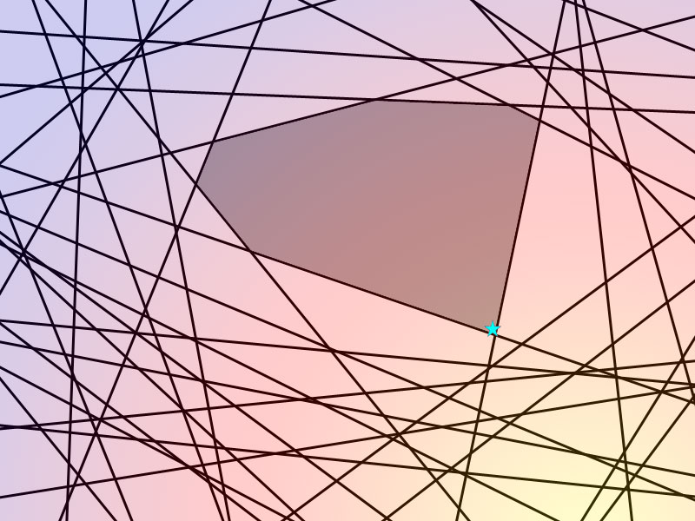

Geometric Example
Naïve SVM Problem
Exponential constraints
Most are dominated by a small set of “important” constraints
Structural SVM Approach
Repeatedly finds the next most violated constraint…
…until set of constraints is a good approximation.
*This is known as a “cutting plane” method.

Slide 32
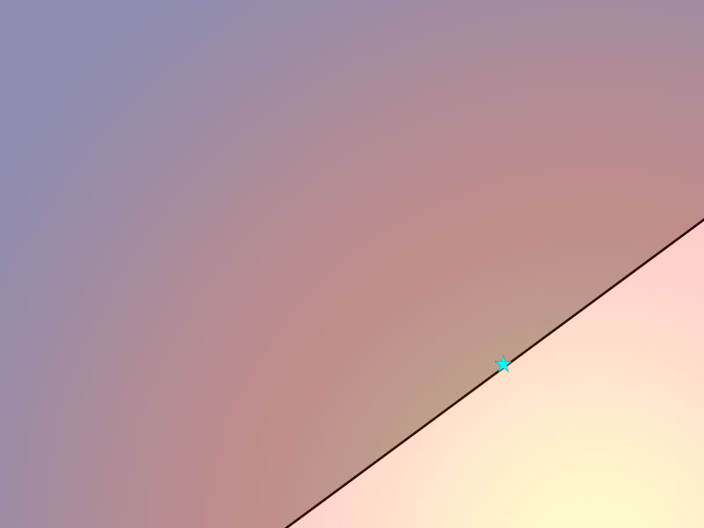
Geometric Example
Naïve SVM Problem
Exponential constraints
Most are dominated by a small set of “important” constraints
Structural SVM Approach
Repeatedly finds the next most violated constraint…
…until set of constraints is a good approximation.
*This is known as a “cutting plane” method.

Slide 33
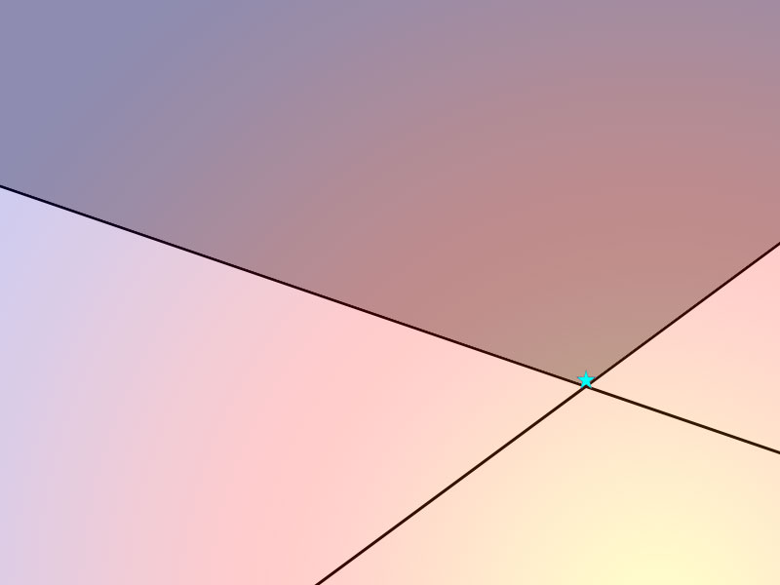
Geometric Example
Naïve SVM Problem
Exponential constraints
Most are dominated by a small set of “important” constraints
Structural SVM Approach
Repeatedly finds the next most violated constraint…
…until set of constraints is a good approximation.
*This is known as a “cutting plane” method.

Slide 34
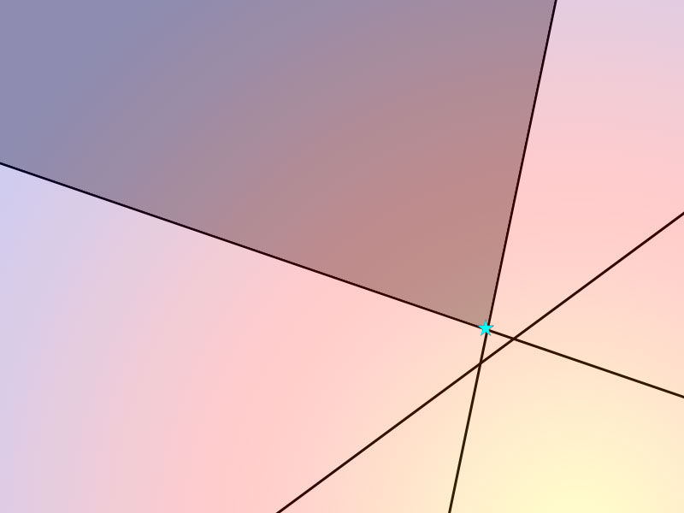
Geometric Example
Naïve SVM Problem
Exponential constraints
Most are dominated by a small set of “important” constraints
Structural SVM Approach
Repeatedly finds the next most violated constraint…
…until set of constraints is a good approximation.
*This is known as a “cutting plane” method.

Slide 35
Linear Convergence Rate
Guarantee for any ε>0:
Terminates after #iterations:
Proof found in:
http://www.cs.cornell.edu/people/tj/publications/joachims_etal_09a.pdf

Slide 36
Finding Most Violated Constraint
A constraint is violated when:
Finding most violated constraint reduces to
Highly related to prediction:
“Loss augmented inference”

Slide 37
“Augmented” Scoring Function
Goal:
Additional
Unary Feature!
Solve Using Viterbi!
Goal:

Slide 38
Recap: Structural SVM
Define structured scoring function:
E.g., 1st order sequential model
Efficient prediction algorithm
Define error function:
E.g., Hamming Loss:
Train by iteratively finding most violated constraint:
Requires efficient algorithm (often same as prediction)

Slide 39
Structural SVMs vs CRFs
SVM Objective:
CRF Objective:
SVM only cares about y’ that
violates margin the most!
Scales margin by loss of y’
CRF cares about all y’ so that:
Incorrect P(y’|x) is minimized
Correct P(y|x) is maximized
http://svmlight.joachims.org/svm_struct.html
http://mallet.cs.umass.edu/

Slide 40
General Structured Prediction

Slide 41
More Elaborate Scoring Functions
Structure encoded by linear scoring function:
2nd Order Sequential Model:
Classification Model:
Efficient Prediction:
Remainder of Lecture:
Tour of Structured Prediction Models
Some Might be Interesting to You…

Slide 42
Graphical Models
…
y⁰
y¹
y²
y³
y^{M}
x¹
x²
x³
x³
Graph structure encodes structural dependencies between y^{j}!
https://piazza.com/cornell/fall2013/btry6790cs6782/resources
http://www.cs.cmu.edu/~guestrin/Class/10708/
https://www.coursera.org/course/pgm

Slide 43
Graphical Models
…
y⁰
y¹
y²
y³
y^{M}
…
…
x¹
x²
x³
x³
Graph structure encodes structural dependencies between y^{j}!
https://piazza.com/cornell/fall2013/btry6790cs6782/resources
http://www.cs.cmu.edu/~guestrin/Class/10708/
https://www.coursera.org/course/pgm

Slide 44
Graphical Models
…
y⁰
y¹
y²
y³
y^{M}
x¹
x²
x³
x³
Graph structure encodes structural dependencies between y^{j}!
Features depend on cliques in graphical model representation.
https://piazza.com/cornell/fall2013/btry6790cs6782/resources
http://www.cs.cmu.edu/~guestrin/Class/10708/
https://www.coursera.org/course/pgm

Slide 45
Tree Structured Models
x¹
y¹
x²
x³
Child nodes of y^{j}
y²
y³
y⁴
y⁵
y⁶
y⁷
x⁴
x⁵
x⁶
x⁷

Slide 46
Prediction via Dynamic Programming
Solve partial solutions of Leaves
Solve partial sol. of next level up
Repeat Step 2 until Root
Pick best partial solution of Root
*Max-Product Algorithm for Tree Graphical Models
*Viterbi = Max-Product for Linear Chain Graphical Models

Slide 47
Loopy Graphical Models
X
Y
Stereo (binocular)
Depth Detection
Each y^{ij} is depth of pixel
Neighbor pixels are similar
Features over pairs of pixels
“Loopy” Graphical Model
Prediction is NP-Hard!
x suppressed for brevity
http://vision.middlebury.edu/MRF/
http://www.seas.upenn.edu/~taskar/pubs/mmamn.pdf
http://www.cs.cornell.edu/~rdz/Papers/SZ-visalg99.pdf

Slide 48
String Alignment
Predict Folding Structure
& Function of Protein
Database D of Known Proteins
(very well studied)
Larger Database G of Homologies
(proteins w/ known similarities to D)
Train on G: learn how to align any amino acid seq to proteins in D
x = pair of strings (one from D)
y = alignment
encodes score of different types
of substitutions, insertions & deletions
http://www.cs.cornell.edu/People/tj/publications/yu_etal_06a.pdf
See Also: http://journals.plos.org/ploscompbiol/article?id=10.1371/journal.pcbi.1000173

Slide 49
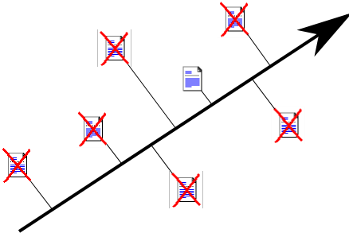
Ranking
Find w that predicts best ranking
of search results.
Every relevant result should be
above every non-relevant result.
x = query & set of results
y = ranking
http://www.cs.cornell.edu/People/tj/publications/joachims_05a.pdf
http://research.microsoft.com/en-us/um/people/cburges/tech_reports/MSR-TR-2010-82.pdf
http://www.yisongyue.com/publications/sigir2007_svmmap.pdf

Slide 50
Summary: Structured Prediction
Very general setting
Applicable to prediction made jointly over multiple y’s
Prediction in Graphical Models
Many learning algorithms for structured prediction
CRFs, SSVMs, Structured Perceptron, Learning Reductions
Topic for Entire Class!
http://www.nowozin.net/sebastian/cvpr2011tutorial/
http://www.cs.cmu.edu/~nasmith/sp4nlp/
http://www.cs.cornell.edu/Courses/cs778/2006fa/
https://www.sites.google.com/site/spflodd/
http://www.cs.cornell.edu/People/tj/publications/joachims_06b.pdf

Slide 51
Next Week
Decision Trees
Bagging
Random Forests
Boosting
Ensemble Selection
Often the most accurate methods in practice.
(Hint: try them for the Kaggle mini-project)

